Slide 1
Binary Numbers
A supplemental lesson for AP CSP

Slide 2
Warm-up
What do you remember about binary numbers?

Slide 3
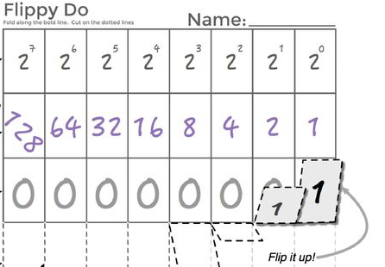
Activity #1:
Get a flippy-do.
Use the flippy-do to convert decimal and binary numbers on your activity guide.

Slide 4
Activity #2:
There are many applications of binary digits and binary numbers.
The word problems in this activity are sample questions that could be asked on the AP Exam, and are applications of binary.
Work through each question and write down the answers in your activity guide.

